Slide 1
Web scraping to gain company insights

Slide 2
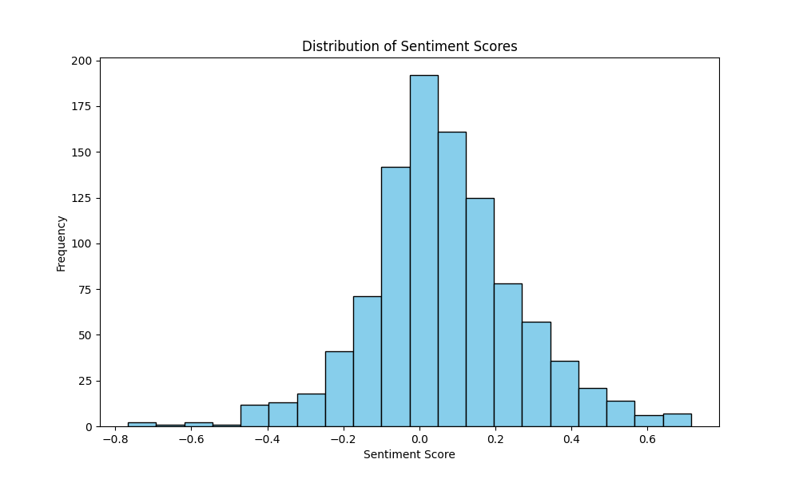
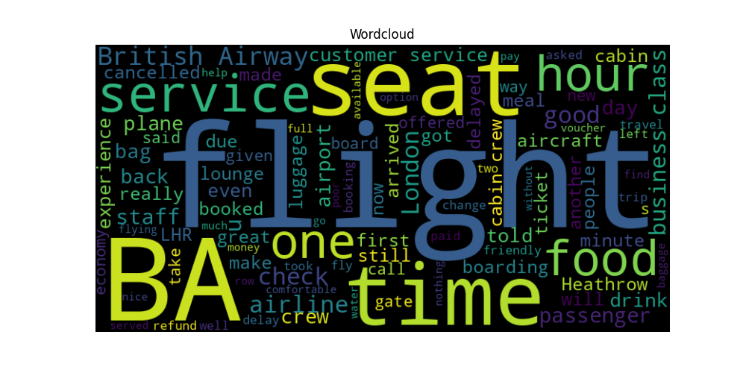
This sentiment analysis chart displays the distribution of sentiment scores extracted from user reviews. The data prominently skews towards positive values, indicating that the majority of users have a positive perception of the service. This prevalence of positive sentiment underscores the overall high satisfaction among users, highlighting the successful aspects of our services.
The word cloud highlights the most frequently occurring words in the user reviews, with “BA“, “seat”, "service“, “time”, and “food" being particularly prominent. The frequent appearance of these terms not only reflects the core aspects that users focus on in their evaluations but also indicates the significant impact these areas have on customer satisfaction. For instance, the prominence of "service" suggests that the quality of service is a critical factor in user reviews, "time" may relate to satisfaction with waiting or processing times, and “food" emphasizes the focus on the food provided during the flight.

